Slide 1
Nameless Eldritch

Slide 2
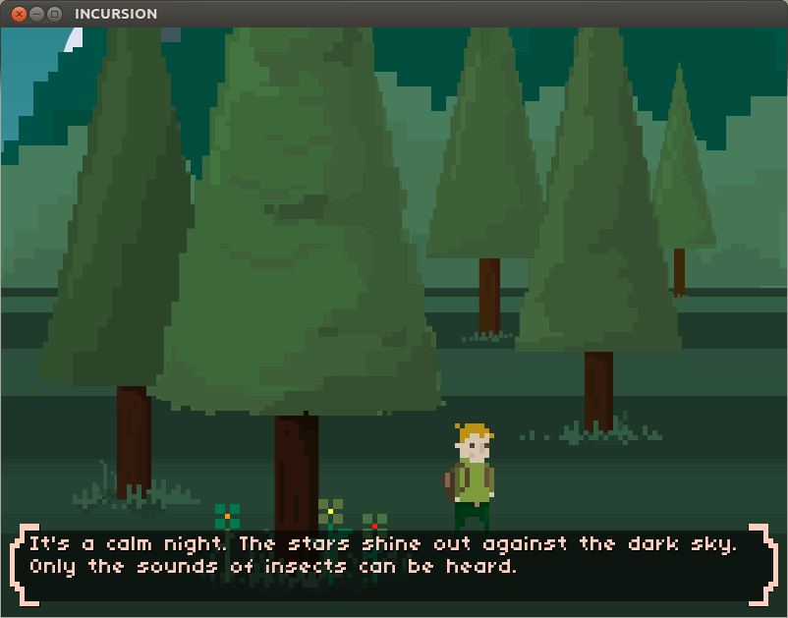
Genre
A merge of text-based adventure game with 2D puzzle focus

Slide 3
Brief Description
Nameless Eldritch is a text-controlled puzzle game, in which the user has to move around the world and solve puzzles using common English to look around and interact with the world around them to progress through the eldritch horror infested world and hopefully try to stop the takeover.

Slide 4
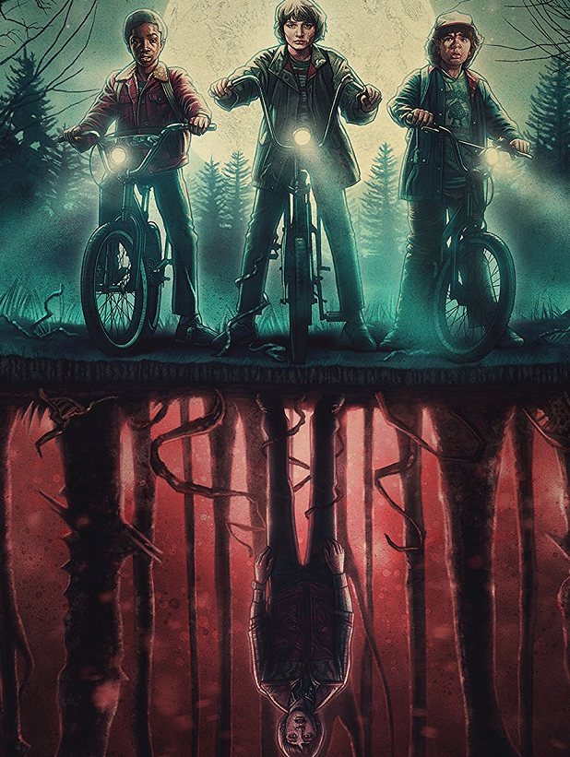
Main mechanics
One of the main mechanics of the game is the ability to access an alternate version of the world, that tends to have slight alterations of the current world (Think like the upside down from Stranger Things). This mechanic will be used as a tool to solve many of the puzzles presented to the player.
Another main feature of the game is how the game is controlled, which is through the use of text commands instead of the typical full control of the movement that is usually granted to players.
One more feature of the game is the combat with eldritch enemies and the options that are provided to the player, such as the ability to talk your way out of combat situation depending on certain stats of the enemies, such as if the enemy has a low confidence, you may be able to end the fight in different ways by talking or fighting the enemy is way linking to their low confidence.

Slide 5
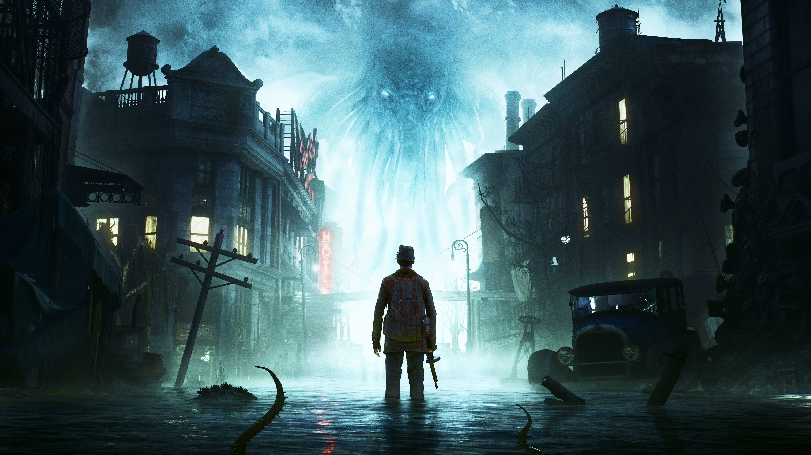
Atmosphere
The setting of this world is split between two worlds, the main world in which eldritch horrors have begun to over run and ruin the world. You will mainly explore an overrun city. The alternate world will take place in the same environment but in a world where the eldritch horror have completely taken over and destroyed the world. Think of a similar atmosphere to The Sinking City, but 2D.

Slide 6
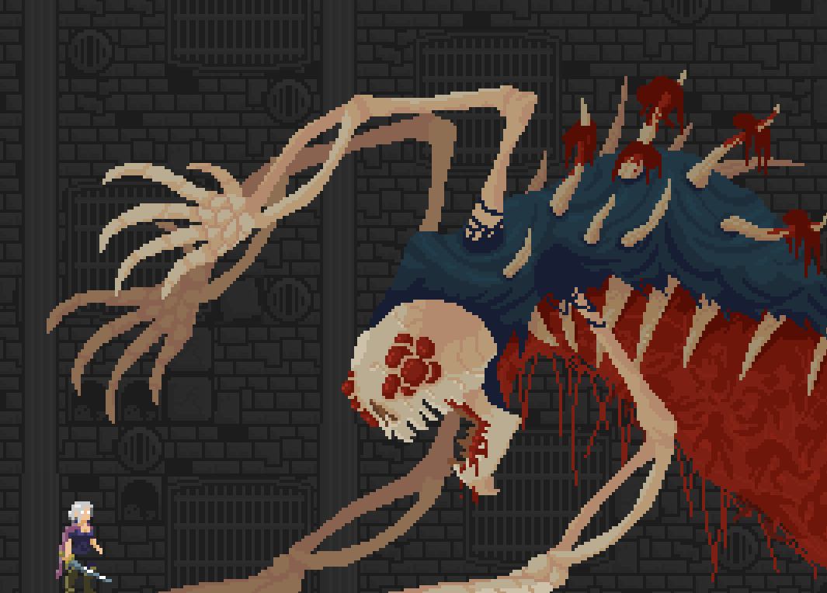
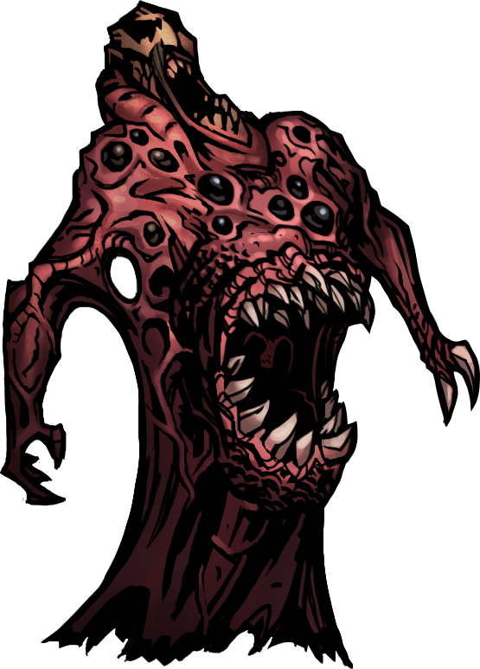
Art style and inspiration
The art style of Nameless Eldritch will be pixel art, similar to the pictures. The environment and enemy design mainly takes inspiration from Darkest Dungeon and the works of HP Lovecraft.

Slide 7

Sound
The atmosphere we are going for is a tense, eerie soundscape that encompasses the distressing feeling of the world being overrun with the eldritch horrors. We are still experimenting with different sound effects and combinations to suit the atmosphere of the game. The soundtrack was created using Magix Music Maker.
Background Music Proposal 1
Background Music Proposal 2
Background Music Proposal 3

Slide 8
Main Roles
Sound Design – Morgan Thomas
Programming – Joseph Thomas
Art Design - Krzysztof Wisniewski
Game Design – Luke Davies

Slide 9
Any Questions?

